Slide 1
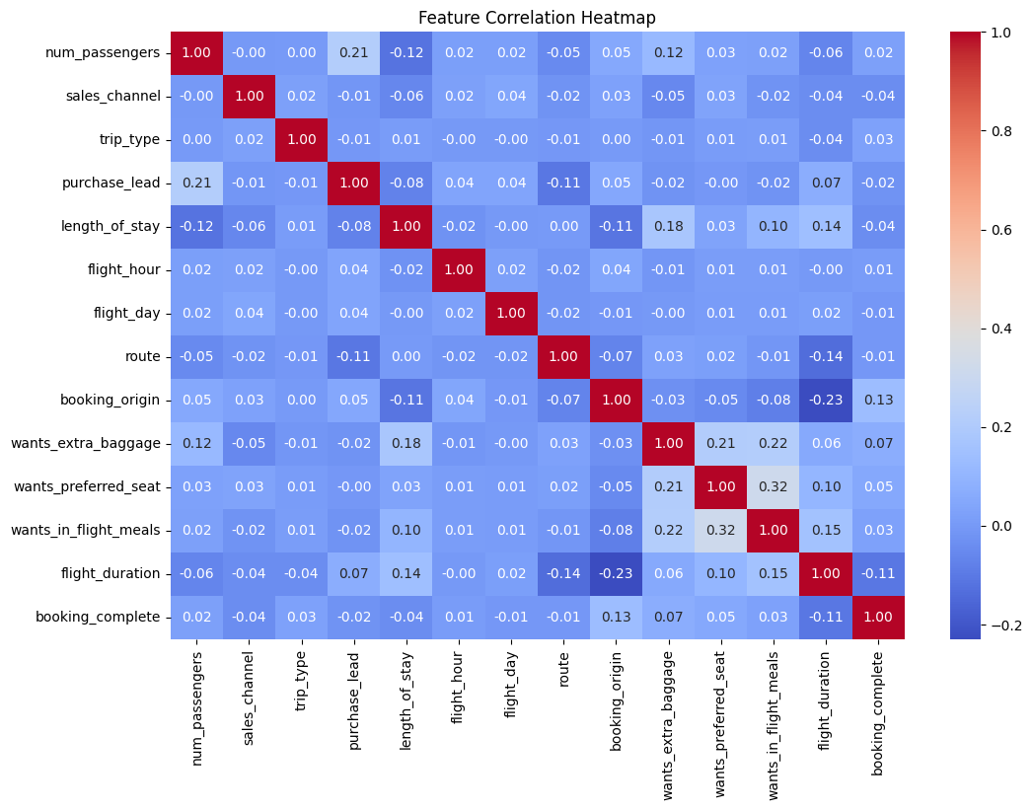
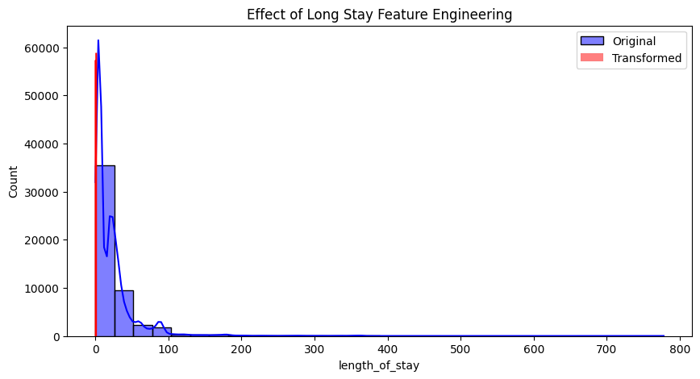
Customer Booking Prediction Analysis
Objective:
Predict customer bookings using machine learning.
Identify key factors influencing bookings.
Dataset Preparation:
Explored key variables and distributions.
Data cleaning: handled missing values, encoded categorical variables.
Created new features to enhance predictive power.

Slide 2
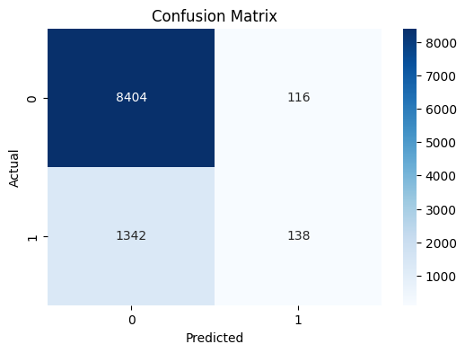
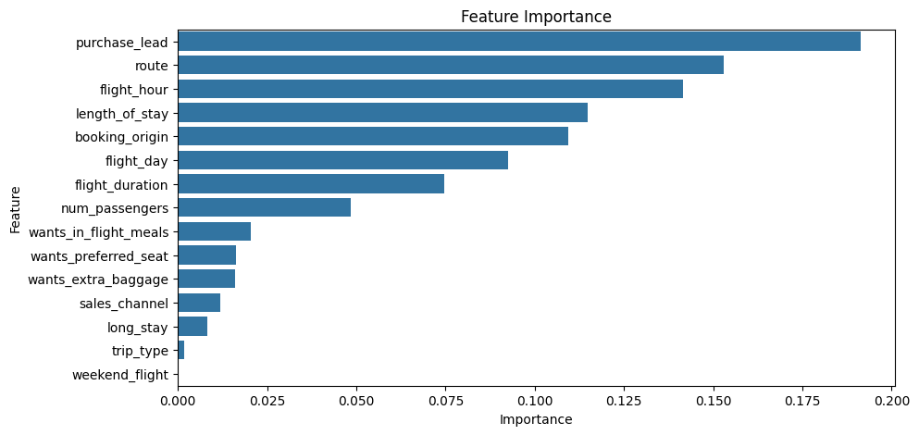
Model Training and Insights
Model & Evaluation:
Trained a Random Forest model for interpretability.
Applied cross-validation to assess performance.
Key Findings: Top factors influencing bookings were identified accordingly as visualized in feature importance for decision-making.
Note: The model's high accuracy masks its severe inability to correctly identify the minority class, as evidenced by the extremely low recall, necessitating strategies to address class imbalance.

